Slide 1
Circus Bot
Team 10 MAE 263: Final Presentation
By:
Jonathan Bopp
Rong Jin

Slide 2
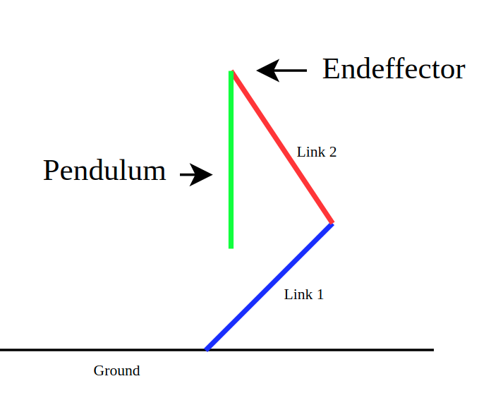
Overview and Objectives
Swing up and stabilization of a pendulum is a classic problem in controls. The nonlinear dynamics of this problem allows for comparison between controllers. The development of a set of controllers to solve this problem using a manipulator would provide interesting insights with regard to system dynamics and control.
This project aims to develop a complete pendulum controller using a two link manipulator. The system is comprised of three identical links.

Slide 3
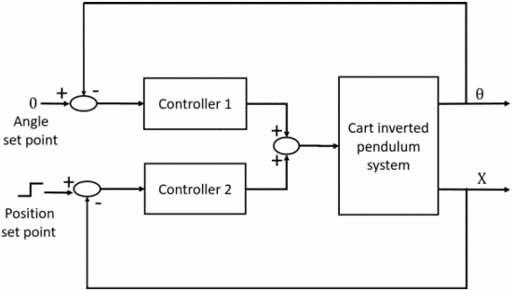
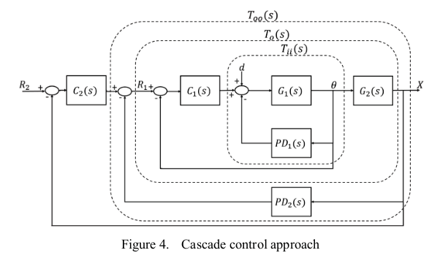
Literature Review
One approach to solving the inverted pendulum problem utilizes a cascade controller approach. The cascaded design ultimately stabilizes the system as the two controllers would account for the angle of the pendulum and the position of the base respectively. This method controls the pendulum and base simultaneously and is tuned with just 3 parameters. As compared to a full state feedback controller with 4.
F. Peker, I. Kaya, E. Cokmez, and S. Atic, “Cascade Control Approach for a Cart Inverted Pendulum System Using Controller Synthesis Method,” in 2018 26th Mediterranean Conference on Control and Automation (MED), Jun. 2018, pp. 1–6. doi: 10.1109/MED.2018.8442552.

Slide 4
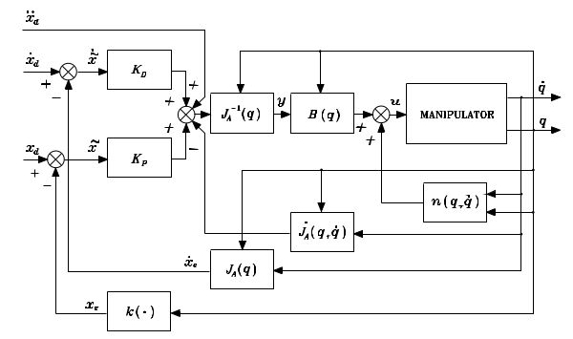
Methods: Inverse Dynamics
3 Link System Dynamics
Pendulum Dynamics
An inverse dynamics controller was chosen to control the manipulator within the 3 link system. The inverse dynamics controller compensates for the dynamics of all 3 links while only providing control inputs to the manipulator. The dynamics of the full system were derived using Euler-Lagrange method accounting for (motor gearing, inertia.etc).
Response requirements Settling time < 0.1sec step response of 0.5m(X&Y)
This was chosen because in order to achieve reasonable performance implementing the outer controllers the inner manipulator controller must be sufficiently quick, the outer controller assume instantaneous response through the manipulator, gain tuning will be necessary to compensate .
B. Siciliano, L. Sciavicco, V. Luigi, and G. Oriolo, Robotics: Modelling, Planning and Control. 2011. doi: 10.1007/978-1-84628-642-1. Pg 347

Slide 5
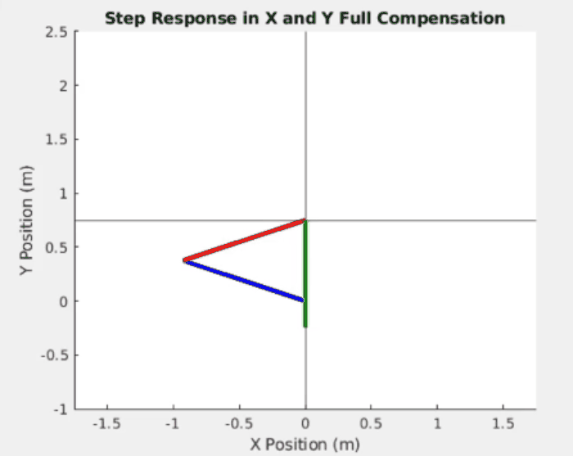
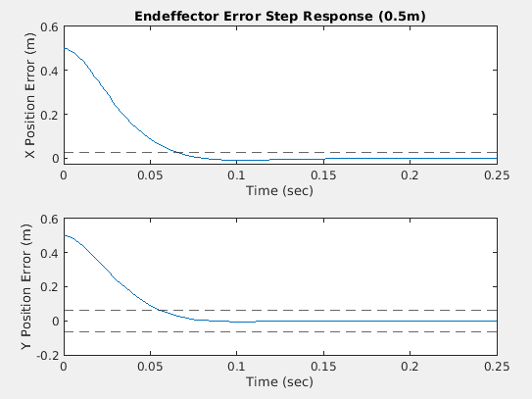
Results: Inverse Dynamics
By compensating for the full system in the inverse dynamics controller a 2nd order response that meets the criteria is achieved.
Dotted lines represent 5% error bounds
Settling Time < 0.1s

Slide 6
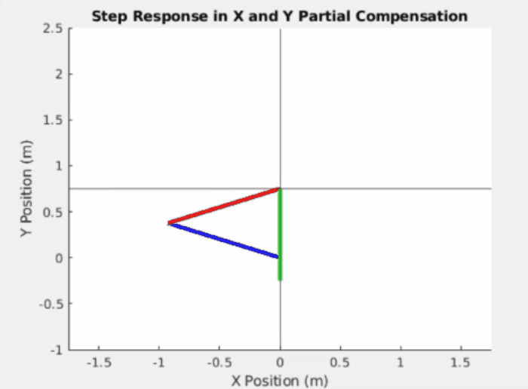
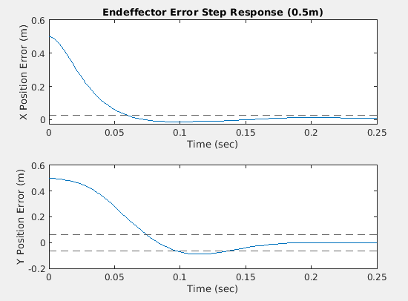
Discussion: Inverse Dynamics
An attempt to treat the dynamics of the pendulum as a disturbance was investigated. Only the manipulator dynamics was compensated for in this inverse dynamics controller.
Dotted lines represent 5% error bounds

Slide 7
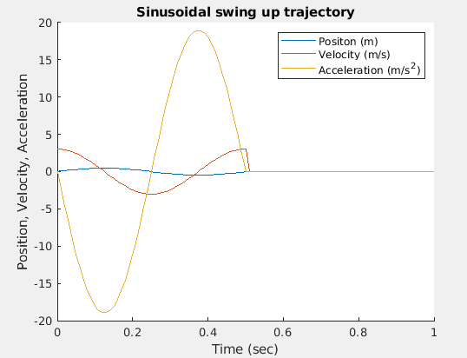
2. Methods: Swing-up
The swing up controller is is an open loop sinusoidal trajectory generator, the tuning parameters for the trajectory are amplitude and duration. In this way the swing up controller can be easily tuned to excite a pendulum into the vertical orientation.

Slide 8
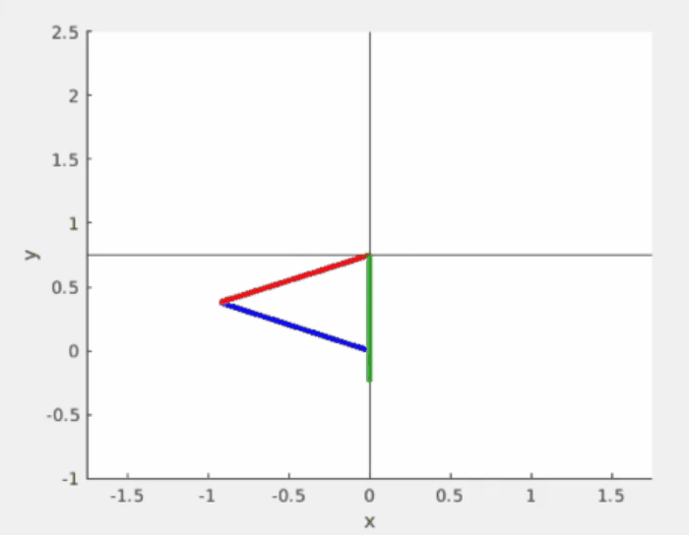
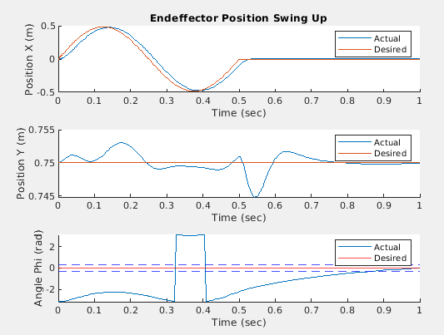
2. Results: Swing-up
Swing up trajectory with an amplitude of 0.485m duration of 0.5s.
Dotted lines represent bounds of swing up controller

Slide 9
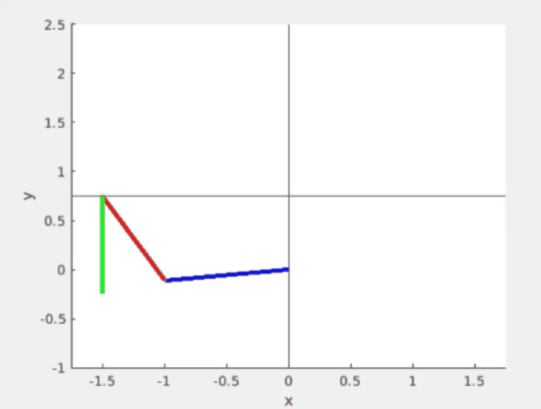
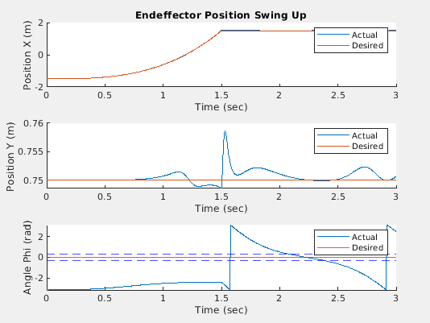
2. Discussion: Swing-up
By using a cubic polynomial trajectory to slowly accelerate the pendulum and then stopping, the pendulum could arrive in the vertical position. Ideally: V_f = Sqrt(2gL)

Slide 10
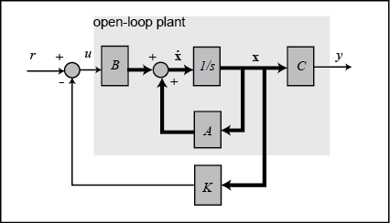
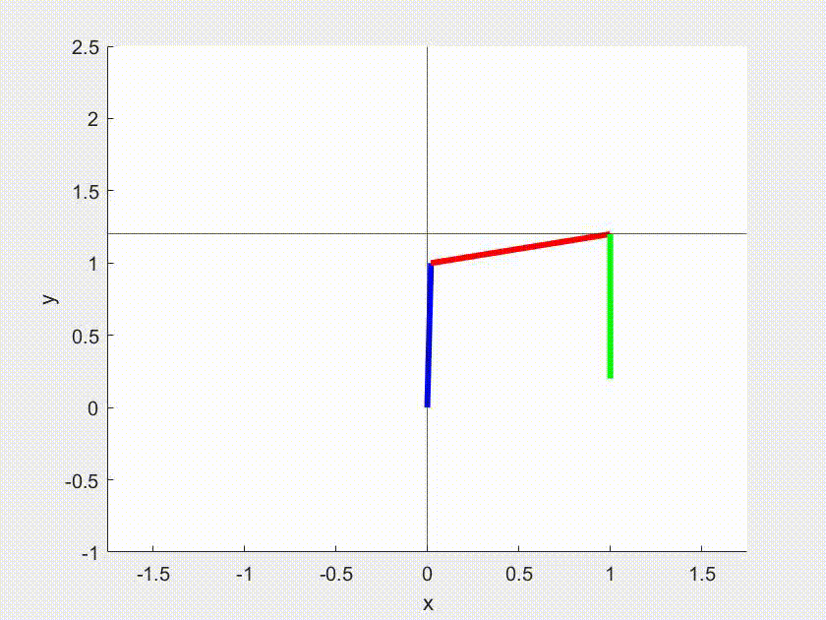
3. Balance Method
Control Method: State-Space Controller with LQR
Approximation: Arm-Pole Balance Cart-pole Balance
Requirement:
theta3 = Pi(base frame), Xd = [0.5; 1.2], Xd_dot = [0; 0]

Slide 11
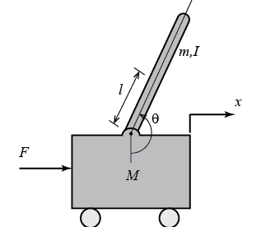

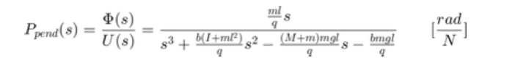
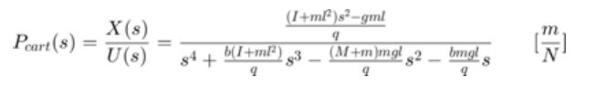
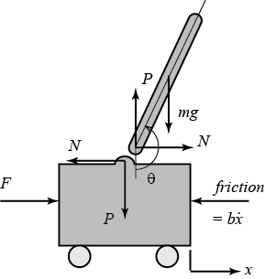
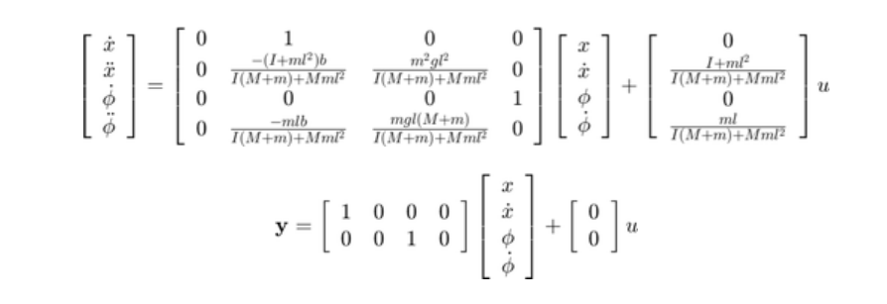
State-Space Controller
Governing Eq & Transfer Function
Recourses: https://ctms.engin.umich.edu/CTMS/index.php?example=InvertedPendulum&section=SystemModeling

Slide 12
Assumptions & Design
Perfect decoupling between 2R arm and the Pendulum
-M = 0
Only horizontal motion allowed
Linear Quadratic Regulation to find the optimal reference gain K
Controller U only affects Translational Acceleration
Full compensated Inverse Dynamics solve for the rest variables

Slide 13
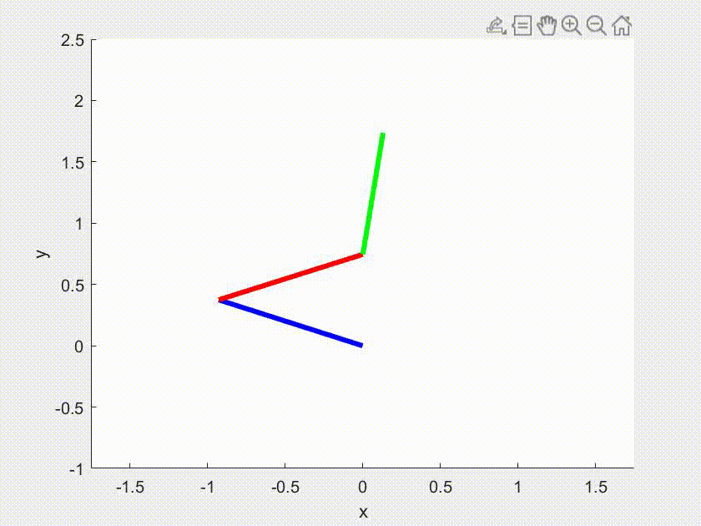
Challenges & Failure
Singularity Conditions
- Limited movability
Vulnerable system due to decoupling
- Initial Configuration (disturbance)
- Initial Velocity
- Desired final Position at the steady state

Slide 14
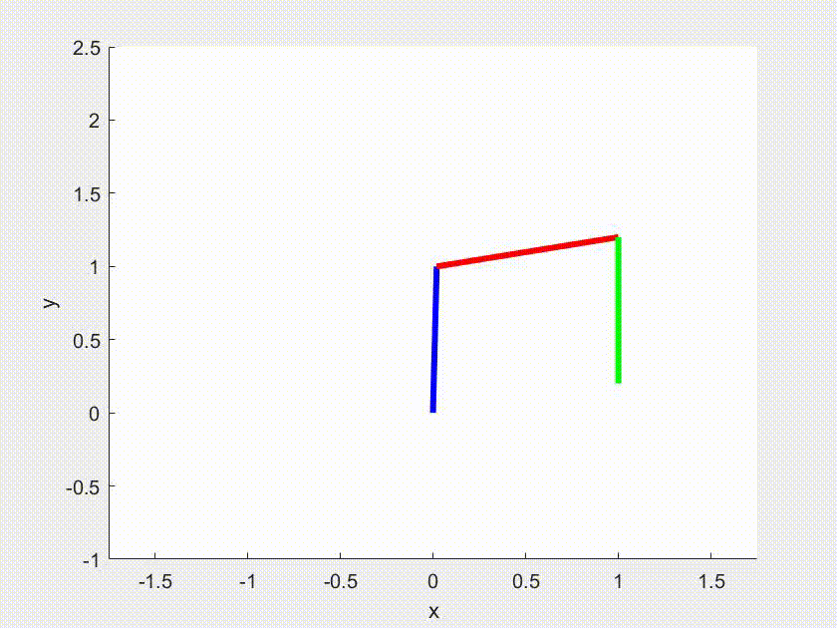
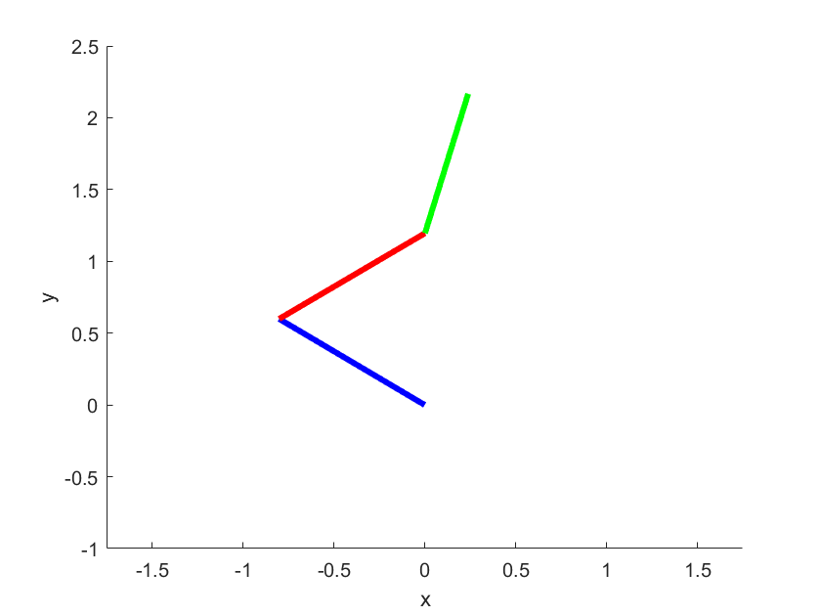
Solution Steps
Separate Swing-Up & Balance Motion
Find the condition suitable for balancing during Swing-up
0.1<= Disturbance <= 0.4, norm(Joint Velocity,2) <=2.5
Extract the data at that configuration
Manually tune reference K to compensate for the decoupling
(if necessary)
Run integrated version if successful

Slide 15
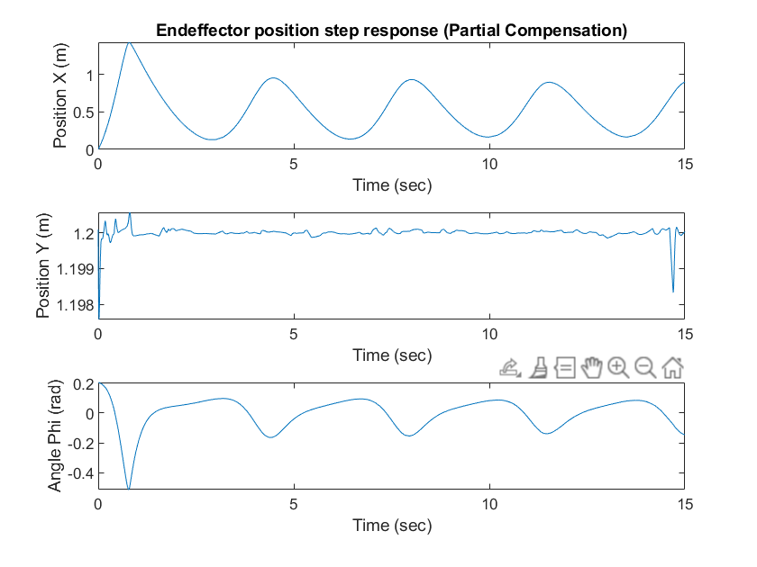
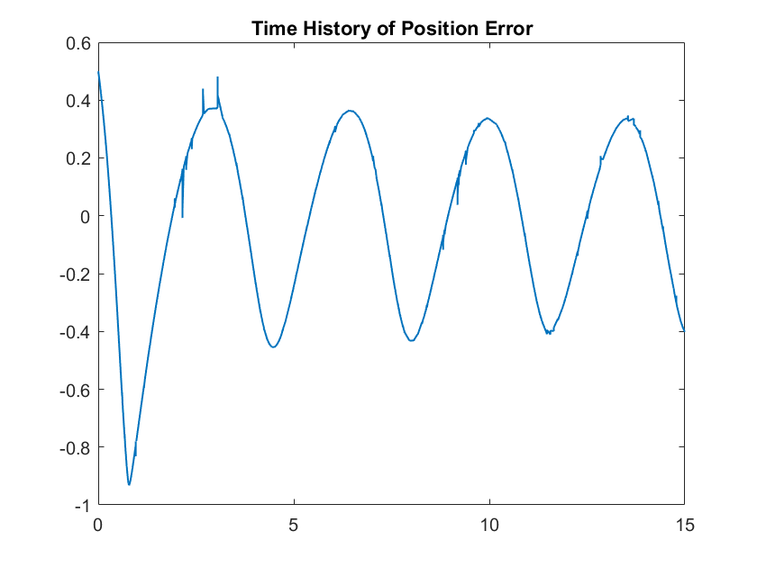
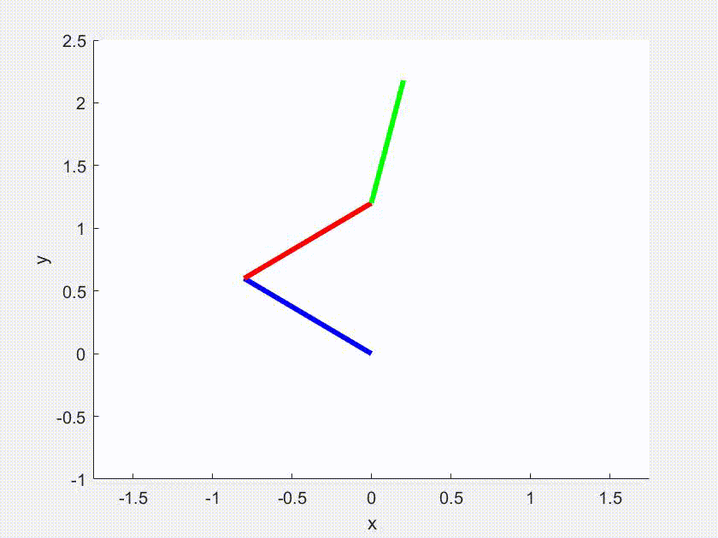
Balance Result
Work, but slow convergence Q11= Q33 = 100, K=[-99, -84.5 35.3 11.5]

Slide 16
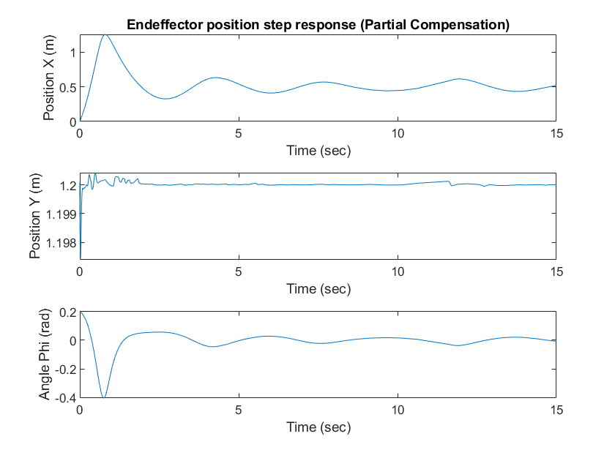
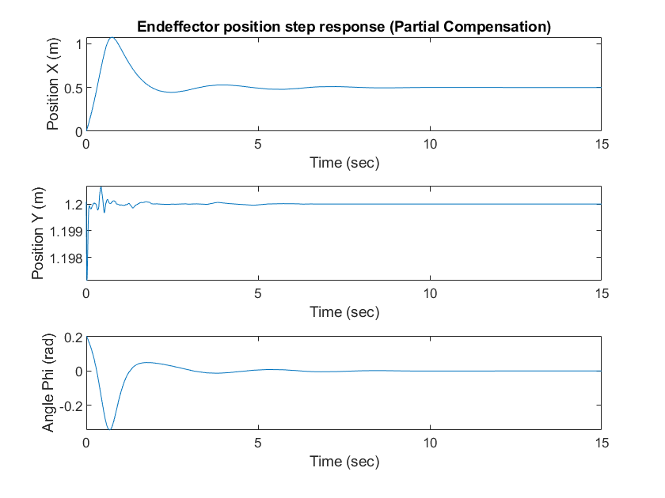
Balance Discussion - Gain K
K=[-99, -84.5 35.3 11.5]
What is K?
X_dot = Ax + Bu
u = -Kx
X_dot = (A-BK)x
K(2) Acceleration
K(2) = -100 = 1.2K(2)
K(2) = -120 = 1.5K(2)

Slide 17
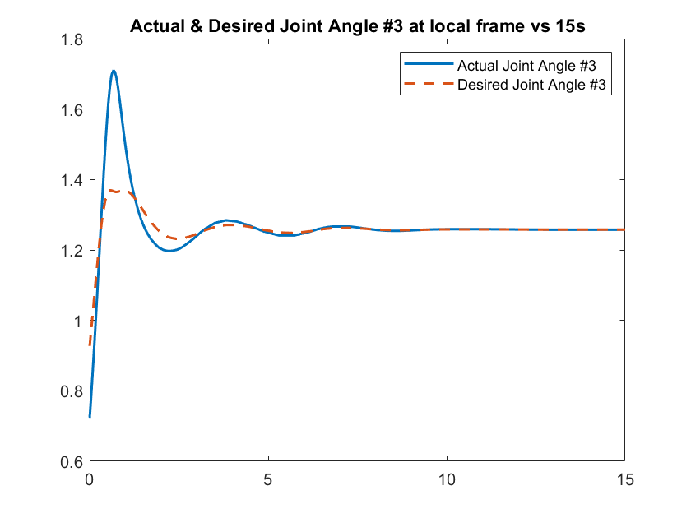
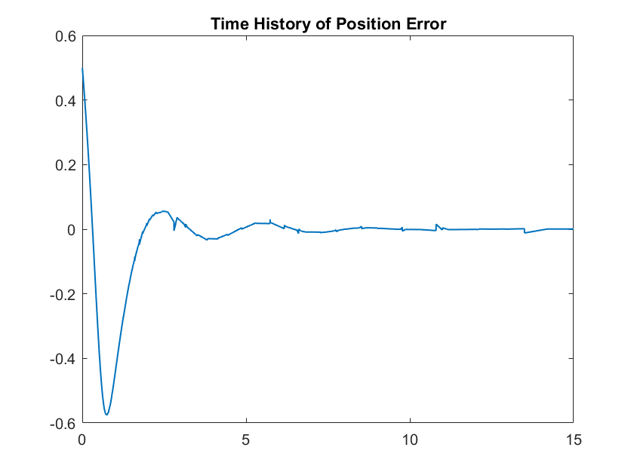
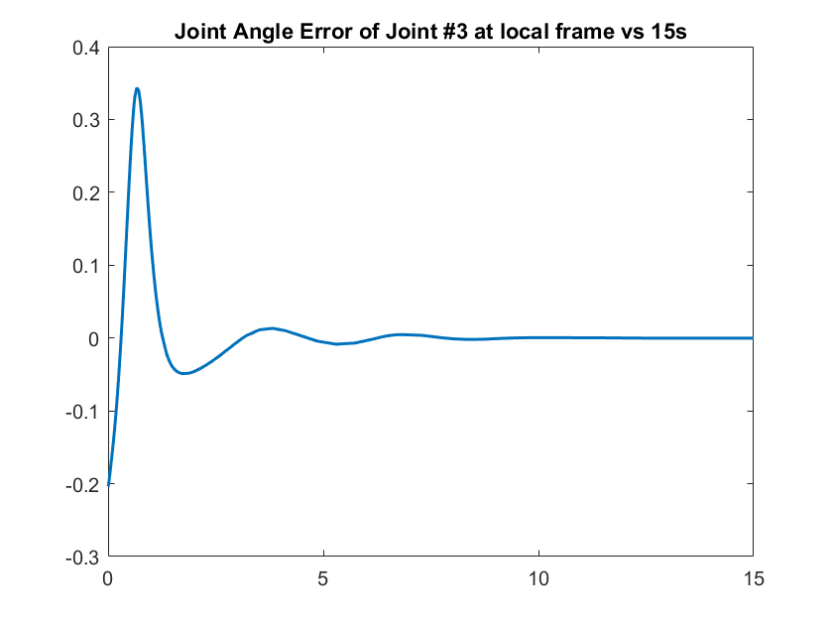
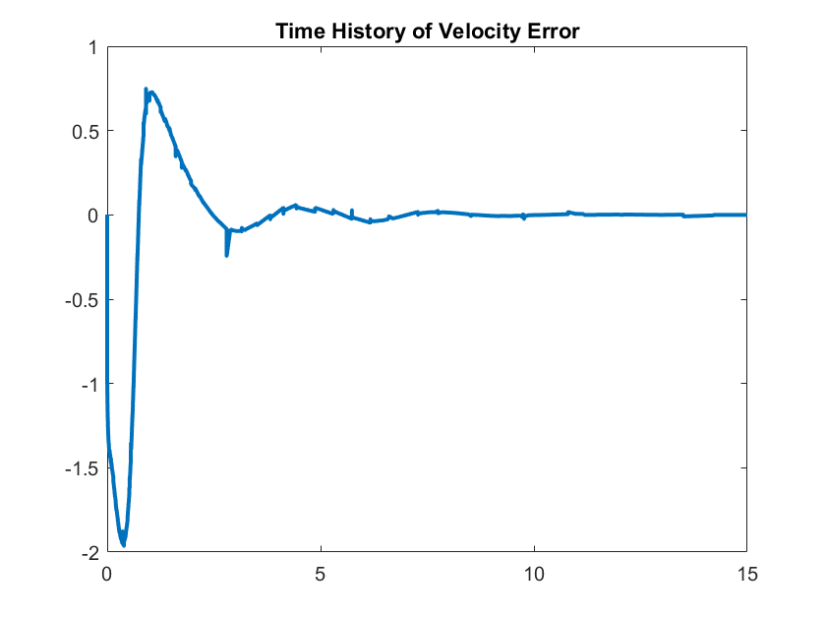
Final Result & Error
K(2) = -120

Slide 18
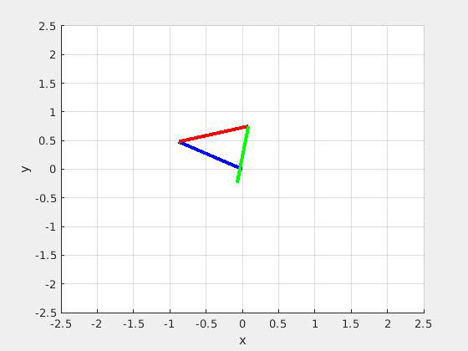
Conclusion
Demonstration of:
Swing Up
Balance
Trajectory Tracking
System Dynamics

Slide 19
Future Directions
1. Use model predictive controller for balancing
2. Develop closed loop controller for swing up routine
3. Implement current controllers on a physical system

